Slide 2

Semantic Analysis of Dreams
Using Text Embeddings
LLM
Home
About
Content
Others
Page 01
Unlimited.
Semantic Analysis of Dreams
Using Text Embeddings
Final Project
Names: Lior Telman Amram, Mor Berger, Linoy Kaufman Supervisor: Ayal Klein
Names: Lior Telman Amram, Mor Berger, Linoy Kaufman Supervisor: Ayal Klein
https://github.com/liortelman/Finall-Project---Dream
-

Slide 3


LLM
Home
About
Content
Others
Page 02
Unlimited.
Choosing Our Embedding Model
Install Sentence Transformers
Choose Embedding Modal - all-MiniLM-L6-v2 * Relatively fast * Gives good quality * Returns a vector of fixed size (384)
We use a BERT-based Transformer model that has been specifically adapted for sentence-level semantic representations, rather than a generic BERT model.

Slide 4
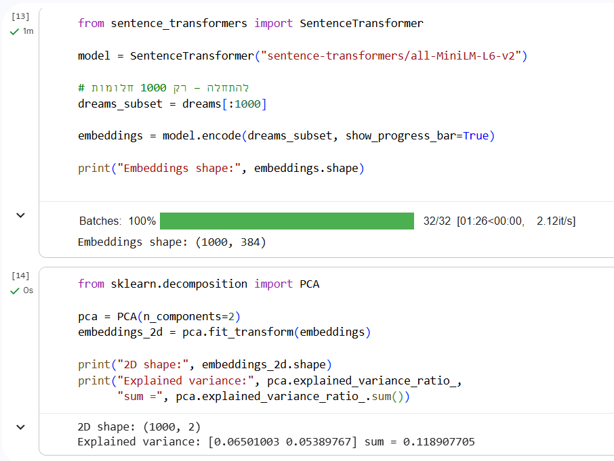
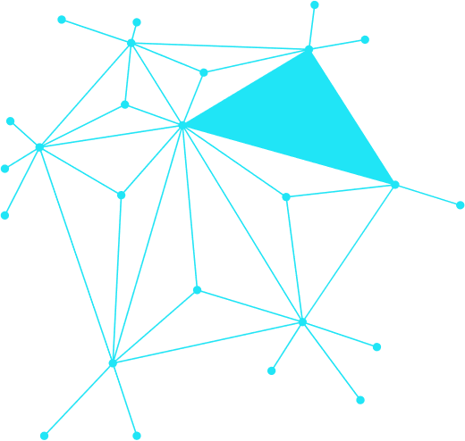
LLM
Home
About
Content
Others
Page 03
Unlimited.
Generate embeddings for real data →→ →→ →→ →→
(We started with 1000 dreams to see if it works)
PCA (on the new embeddings) →→ →→ →→ → →→ -Makes every dream represented by two numbers

Slide 5
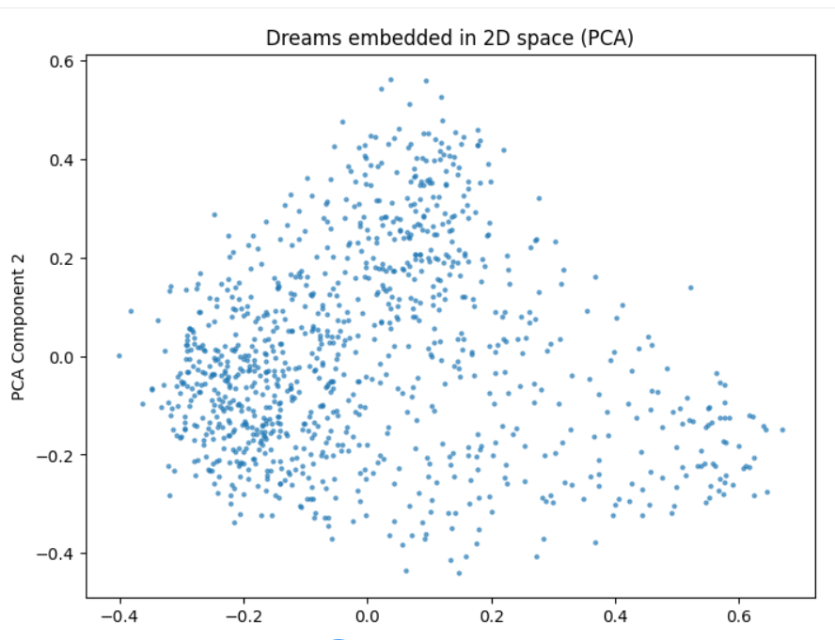
LLM
Home
About
Content
Others
Page 04
Unlimited.
🔹 Each Dot = Dream
🔹 Proximity Between Dots = Semantic Similarity
🔹 Dense Areas = Similar Dreams

Slide 6

LLM
Home
About
Content
Others
Page 05
Unlimited.
Interpreting PCA Component 1 and PCA Component 2
We aim to interpret the two PCA axes - Component 1 and Component 2 - in order to understand what underlying themes they represent and how the model positions each dream along these dimensions.

Slide 7

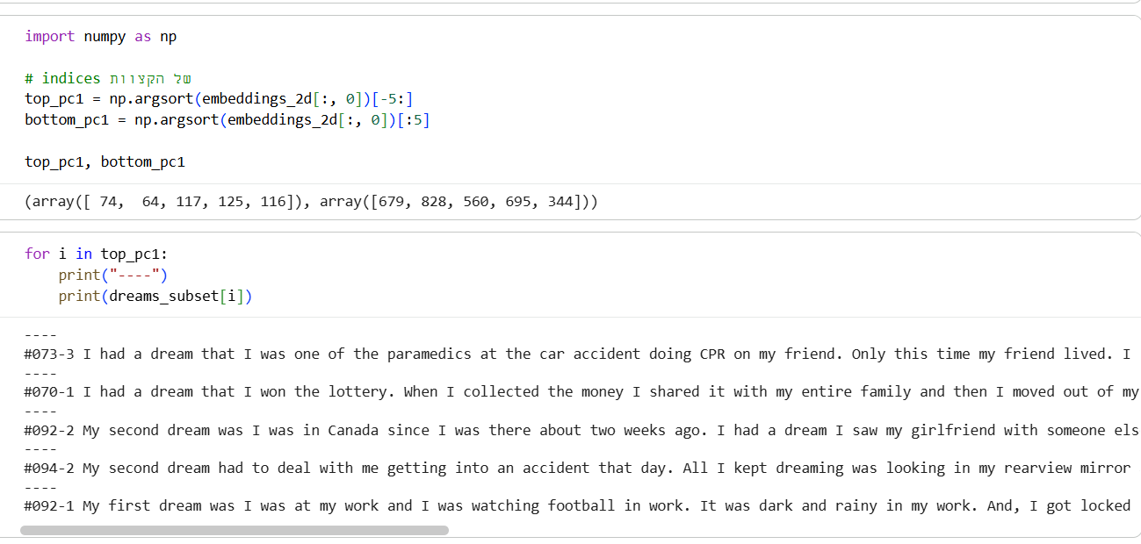
LLM
Home
About
Content
Others
Page 06
Unlimited.
Checking the edges:
We want to see:
Dreams with very high value
Dreams with very low value
(Now for PCA1)
Risk Mitigation:
Predict and prevent potential issues with data-driven foresight.
Results:
The five most extreme dreams for PCA1
Competitive Edge:
Stay ahead of trends and market shifts.

Slide 8
LLM
Home
About
Content
Others
Page 07
Unlimited.
Analysis with chatGPT
What do the dreams we reviewed have in common? (First insight) If you look at them one by one:
1. CPR / car accident / fractures / survival 2. Lottery win → dramatic life change 3. Jealousy / loss of connection / helplessness 4. Repeated accident / nightmare / lack of control 5. Locked out at work / loss of control over the situation
The clear theme connecting them: Strong emotional states + a sense of losing control + a major event (danger, loss, extreme change, or survival)

Slide 9
LLM
Home
About
Content
Others
Page 08
Unlimited.
Interpretation of the Opposite Side of PCA1
Recurring themes:
1. Restaurants, stores, waiting in lines, shopping
2. Work, responsibilities, money, payments/collections
3. Family, children, everyday relationships
4. Etiquette, rules, and “what is the right thing to do”
5. Mild discomfort or worry, but no real danger
Absent themes:
Major accidents
Death or survival
Nightmares
A single extreme event that dominates the entire dream

Slide 10
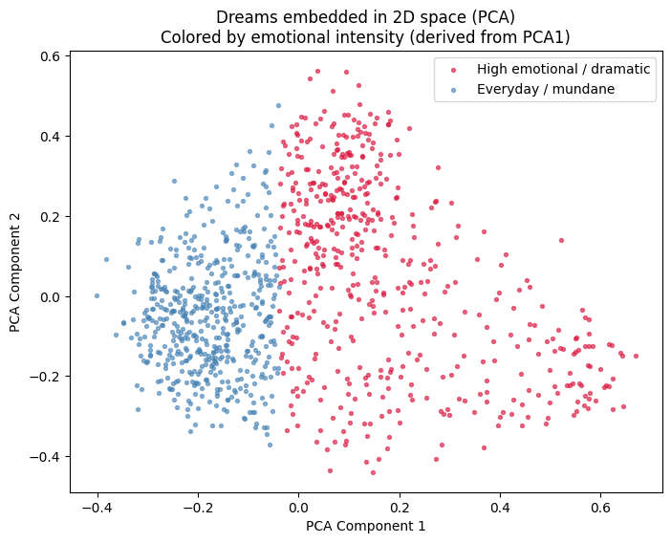
LLM
Home
About
Content
Others
Page 09
Unlimited.
Right Side | Left Side
Accidents, CPR, nightmares | Restaurants, work, shopping
Loss / danger | Everyday management
Intense emotional drama | Minor worries
Feeling of losing control | Attempt to maintain control

Slide 11

LLM
Home
About
Content
Others
Page 10
Unlimited.
Interpretation of PCA2: High vs. Low Values
High PCA2 — Cognitive / Procedural Dreams
Key characteristics:
Offices, computers, forms, spreadsheets
Administrative or organizational work
Categorizing, structuring, marketing tasks
Dry, descriptive language
Minimal emotional content
No danger, no conflict, no drama Dream type: Cognitive, procedural, functional
Low PCA2 — Emotional / Instinctive Dreams
Key characteristics:
Strong interpersonal conflicts
Jealousy, violence, betrayal
Fear, shame, guilt, anger
Intense bodily experiences (running, fighting, falling…)
Loss of control
Extreme emotional reactions
Dream type: Experiential, emotional, instinctive

Slide 12
LLM
Home
About
Content
Others
Page 11
Unlimited.
Two Different Axes of Emotion: PCA1 vs. PCA2
Summary | Typical Features | What It Measures | Component
Content-driven intensity | Drama, danger, major events, high emotional stakes | How strong the emotion is | PCA1 Emotional Intensity
Body-driven emotional experience | Physical sensations, instinctive reactions, being “inside” the experience | How the emotion is felt in the body | PCA2 Experiential-Emotional

Slide 13
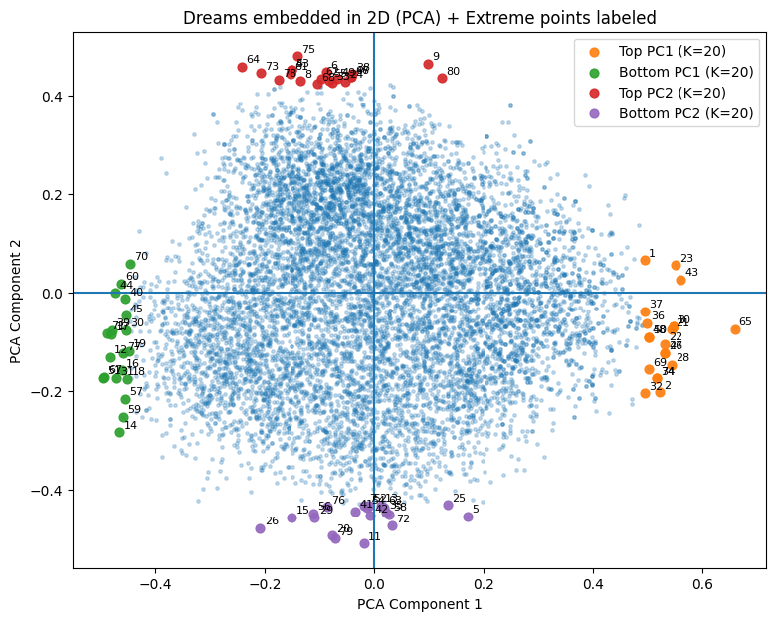
LLM
Home
About
Content
Others
Page 12
Unlimited.
With 10,000 dreams & 80 points

Slide 14
LLM
Home
About
Content
Others
Page 13
Unlimited.
Example Extreme Dreams | Semantic Interpretation | Direction | PCA Axis
• Dream of marrying a man, doubting the relationship, house fire, heroic rescue, emotional resolution • Dream about protecting a woman from an evil husband, cremation, historical figures, layered narrative | Long, emotional, symbolic narratives Rich inner conflict, relationships, moral dilemmas, transformation | Low | PC1
• “I was at a shop with Mom and Ezra, but that’s all I remember.” • “I vaguely remember Robert Downey Jr and that’s all.” | Short, observational, memory-like dreams Minimal plot, pop-culture references, weak emotional load | High | PC1
• Setting up a family feast table and organizing dishes • Working at a computer preparing booklets and materials | Routine, task-oriented, organizational dreams Work, logistics, cleaning, responsibility, control | Low | PC2
• Intruder entering the house at night, fear, calling mother repeatedly • Being chased by a rapist, unable to call for help, intense panic | Threat, fear, chaos, loss of control Violence, pursuit, death, paranoia, nightmares | High | PC2
PC1 captures Narrative Depth PC2 captures Emotional Intensity / Threat | Overall structure | — | —

Slide 15
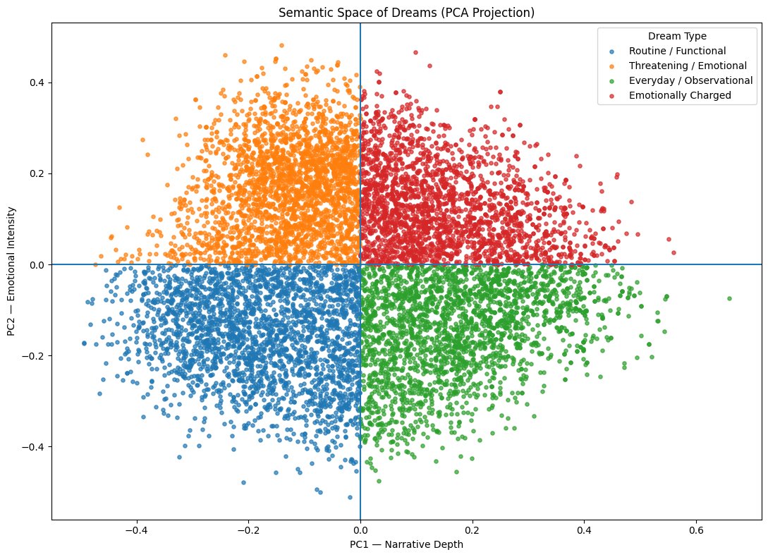
LLM
Home
About
Content
Others
Page 14
Unlimited.
Conclusion
There is no fundamental change in the structure of the semantic space. The main insights are:
PC1 captures narrative depth-meaning is distributed across the entire dream rather than isolated events.
PC2 captures experiential intensity- distinguishing routine, task-oriented dreams from rare, emotionally charged events. However, this information does not carry broader interpretive significance

Slide 16
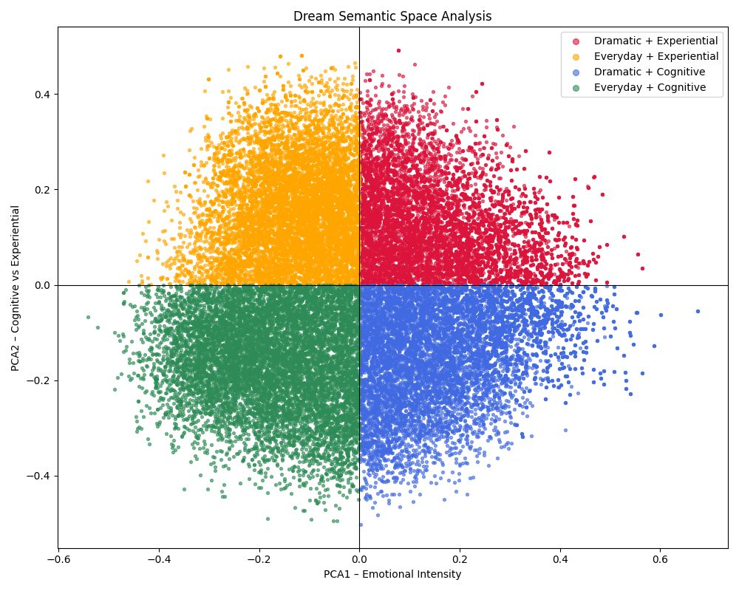
LLM
Home
About
Content
Others
Page 15
Unlimited.
Characteristics | Interpretation | Quadrant
Dramatic + Experiential | Nightmares, fear, violence, jealousy | Top–Right
Everyday + Experiential | Personal emotional tension, discomfort | Top–Left
Dramatic + Cognitive | A major event described from a distance | Bottom–Right
Everyday + Cognitive | Work, organization, routine | Bottom–Left

Slide 17
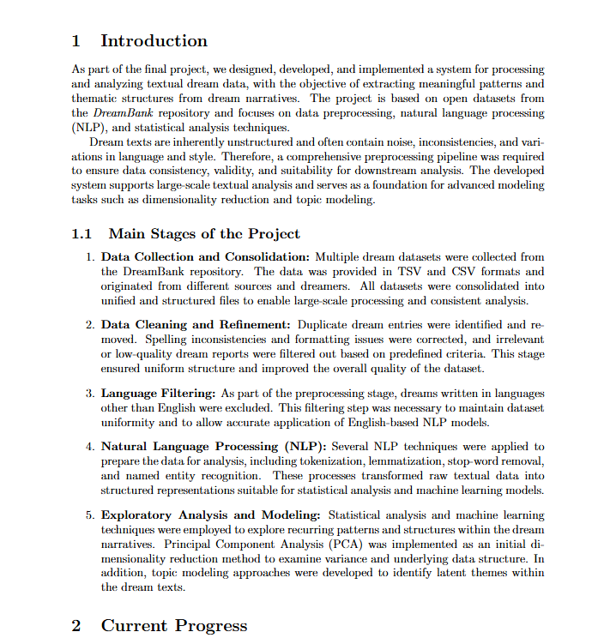
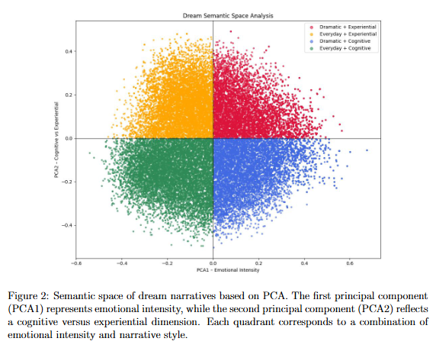
LLM
Home
About
Content
Others
Page 16
Unlimited.
overleaf
https://www.overleaf.com/project/

Slide 18

LLM
Home
About
Content
Others
Page 17
Unlimited.
Next…
שינוי מודל
להחליף PCA ב-UMAP / t-SNE או משהו אחר, ולראות אם המבנה נשמר
נבדוק האם הקצוות נשארו כמו שהם גם בהפחתת ממדים לא-ליניארית. אם ב-UMAP עדיין רואים separation דומה, זה מחזק מאוד את התוצאה שלנו.
בדיקת מאפיינים נוספים
“אורך חלום” / “כמות דמויות” / “דיאלוג” לדוגמה. אלו משתנים כמותיים שאפשר לבדוק בלי מודל נוסף.
בדיקה של אורך טקסט (מס’ מילים/תווים), מס’ שמות פרטיים , פשוט או מילים עם’ מרכאות
לראות אם איזורים מסוימים מחולקים לפי אורך החלומות.
מציאת נקודת ה0, ומהם הפרמטרים הכי ניטרליים
בדיקת שכנים קרובים
האם יש “אשכולות משמעות” בין שכנים קרובים. נבדוק האם נקודות קרובות באמת דומות תוכן בעזרת בחירת חלומות רנדומליים, והוצאת עבורם שלTop-10 שכנים
נרצה לראות האם חוזרים אותם נושאים על מנת לאמת שהאמבדינגס עובדים סמנטית.
יציבות של הצירים (Sanity check )
לבדוק האם PCA1/PCA2 “אמיתיים” או סתם תוצאה של מדגם ספציפי.
בדיקה של קצוות יותר רחבים (לדוגמה – בדיקה של ה20 הקיצוניים לכל החלומות
ניסיון עם מודלים מבוססי BERT אחרים
-

